Slide 2
OVERViEW
40% more energy for your battery

Slide 3
IMAGiNE
Your EV range is extended by up to
All yours electric devices have
longer run time by
+40%
40%
or have the same range
with a much lighter battery
Notes:
Imagine… Your EV have either
1. Extremely extended range
or
2. Have the same range, with a much smaller (& lighter) battery
…your EV has the SiliB Battery Technology

Slide 4
THE GRAPHiTE LiMiT
& the silicon challenge
Graphite
C
C
C
Graphite as anodic material has reached it maximum capacity
Silicon holds up to 10X more lithium than graphite
But - up to 300% changes in volume during cycling
Cracking of the anodes over time
Bottom line – rapid capacity degradation, not a practical solution
Li
C
C
C
Silicon
Li
Li
Si
Li

Slide 5
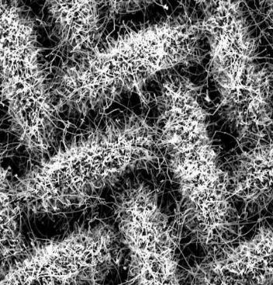
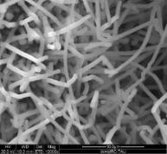
SiliB SOLUTiON
for the challenge
Innovative 3D nano structure on a thin mesh
Absorbs the volume changes – reducing volume related cracking
Single stage low cost manufacturing process
100% silicon – no catalysts, no alloys, no additives

Slide 6
WHERE iS THE ENERGY BENEFiT?
Lower volume for same amount of energy
-40%
Graphite anode
Silib silicon anode
Separator
Separator
Cathode
Cathode
Graphite inside
SiliB inside

Slide 7
UNiQUE SELLiNG PROPOSiTiON
Technical advantages
$
Low-cost process
The only company that has non PECVD process
No catalysts used
No preciouses metal used as catalysts
No additives
No binders or graphite added
Easy to scale up
Simple off the shelf manufacturing equipment
The only pure silicon anode for mass markets
Resolve graphite supply chain issues in the EU
Notes:
UNiQUE SELLING PROPOSITION

Slide 8
A DYNAMIC BUSINESS MODEL
Batteries to end users
We Produce cells at a 3rd
party facility
1
Direct anodes sales
Mass produce and / or semi licensing of the anode tech
2
Notes:
We are an anode company not a battery company
https://depositphotos.com/645363660/stock-photo-copper-electrolysis-cathode-plates-copper.html

Slide 9
WHAT and WHERE
Israel
Core R&D
Next gen of anodes
Improve cycle live
Development of Manufacturing tech
Developing manufacturing technologies
Evaluation of changes in manufacturing processes
Small scale POCs
Germany
Pre-manufacturing
Design of scaled equipment
Facility set-up
Deployment of Gen1/2 furnaces
Manufacturing
Commissioning large scale equipment
Evaluation of changes in manufacturing processes and QC
Large scale POCs
Bi directional team support
Notes:
Funding Historical & Series A

Slide 10
SUSTAINABILITY
FACTS
20% of CO₂ emissions are driven by consumer vehicles
20% of new car buyers consider EV
For half of them range is a deal breaker
Translates in to 8M potential buyers
Each ICE car replaced by EV saves 15T of CO₂ (over the car life cycle)
Silib’s battery impact
By using Silib’s batteries we can increase EV range by up to 40%
Adding million of new EVs every year
Mega scale reduction of CO₂ emissions
[1] https://www.iea.org/reports/global-ev-outlook-2024/trends-in-electric-cars
[2] McKinsey Mobility Consumer Pulse, Media presentation, June 2024
[3] A comparative evaluation of CO₂ emissions between internal combustion and electric vehicles in small isolated electrical power systems - Case study of the Canary Islands,
https://doi.org/10.1016/j.jclepro.2022.133252
Notes:
Funding Historical & Series A

Slide 11
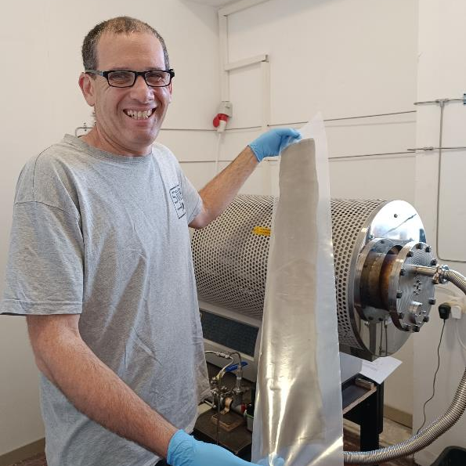
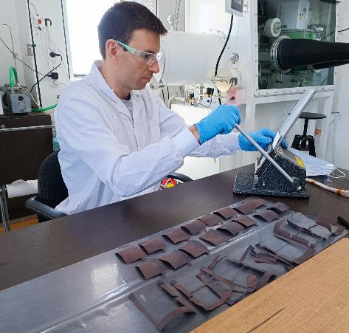
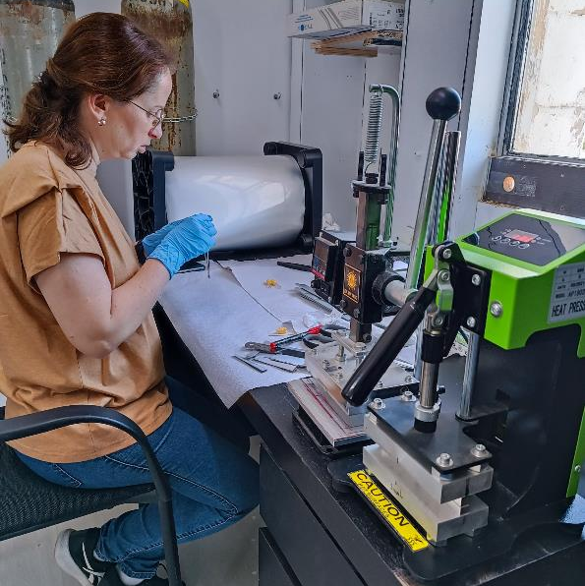
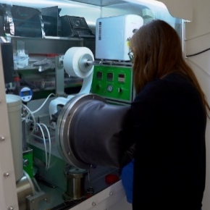
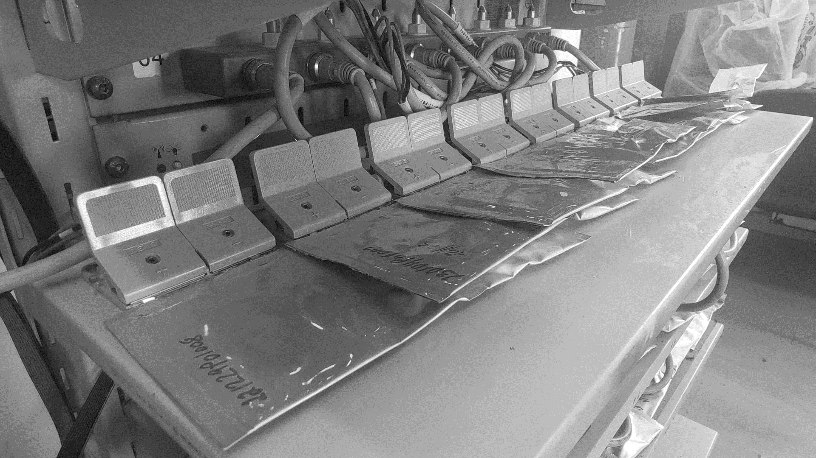
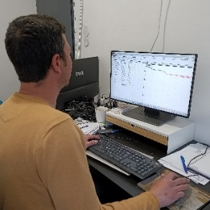
FULL iN-HOUSE CAPABiLiTiES
From A-Z pure silicon anode
Electrode manufacturing
Anode preparation
for cell assembly
Cell components preparation
Cell assembly
Cell testing
Manufacturing line design
Notes:
UNiQUE SELLING PROPOSITION

Slide 12
Thank you
For more details
Arnon Blum
Arnon.Blum@si-lib.com

